Slide 1
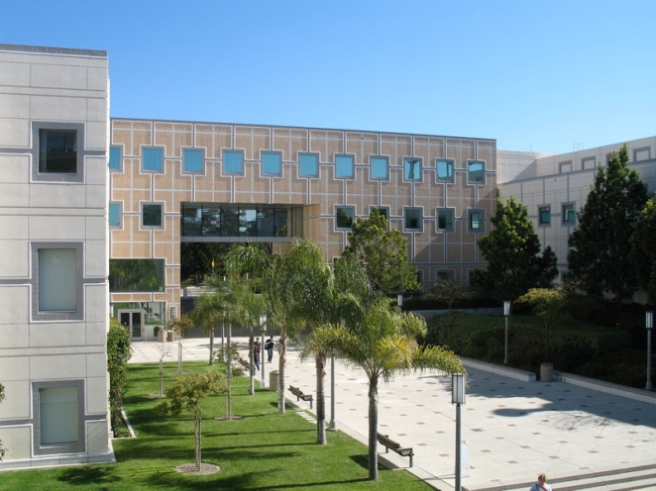
MAE 256 - Nanomechanics
Tim Rupert
Winter 2020
Fundamentals of Dislocations

Slide 2
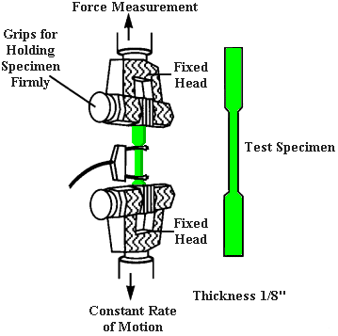
Theoretical Strength
What should the strength of a perfect lattice be?
Phenomenological observations suggest that we must have slip. The simplest way for this to occur would be through rigid translation of a section of the crystal.
To do this, we would have to translate an entire row of atoms over another.

Slide 3
Rigid Slip
x
The shear stress needed to displace the plane of atoms can be approximated by a sine function
a
τ_{max}
b
Displacement (x)
Shear Stress (τ)
$$τ= τ_{max}\sin\left(\frac{2πx}{b}\right)$$
$$τ= τ_{max}\frac{2πx}{b}$$
For small values of x/b,
b
$$τ=Gγ=G \left(\frac{x}{a}\right)$$
From elasticity,
$$τ_{max}= \left(\frac{b}{a}\right)\left(\frac{G}{2π}\right)$$
$$τ_{theoretical}≈ \left(\frac{G}{10}\right)$$
$$τ_{exp}≈ \left(\frac{G}{1000}\right) ↔\left(\frac{G}{1000000}\right)$$

Slide 4
Dislocations
Even with more accurate theory and calculations, theoretical strength is a least 100 times greater than observed strength!
Simple Cubic Lattice
In 1934, Taylor, Orowan, and Polanyi independently proposed that dislocations (2D or line defects) in crystal packing could explain this discrepancy.
a
Edge Dislocation → extra half-plane of atoms
(atoms far away are still in minimum energy positions)
a
a

Slide 5
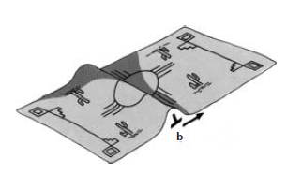
Slip by dislocation motion
While many atoms must be displaced at once for perfect/rigid slip, a dislocation can move through the crystal with very small movements localized around the dislocation core.

Slide 6
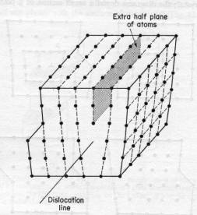
Slip by dislocation motion
While many atoms must be displaced at once for perfect/rigid slip, a dislocation can move through the crystal with very small movements localized around the dislocation core.
Line Direction: (t)
Defines the location of the dislocation; boundary between slipped and unslipped region
For an edge, t runs along the bottom of the extra half-plane
Burgers Vector: (b)
Defines the slip direction
For an edge, b is perpendicular to t

Slide 7
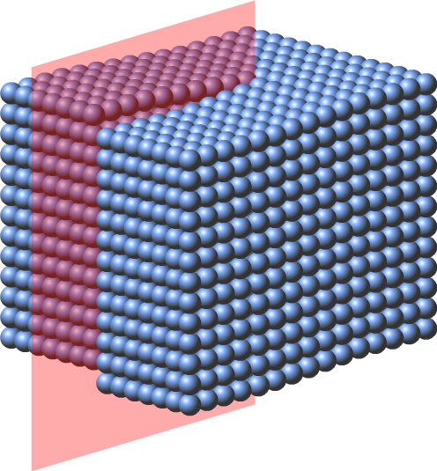
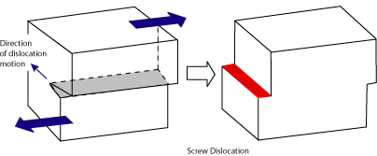
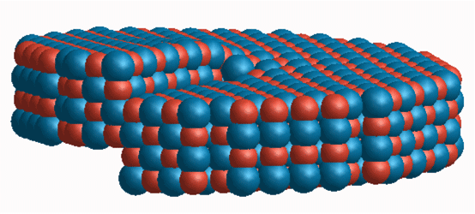
Screw Dislocations
We could also displace our crystal parallel to our dislocation line, to create a screw dislocation.
Slip is still driven by shear stress.
This configuration creates a screw-like pattern of atomic displacements.

Slide 8
Dislocations in “real” crystals
We’ve been looking at simple cubic structure, but no real engineering materials have this structure. Most engineering metals form in one of three well-known crystal structures.
[001]
Basic terminology of crystallography:
Directions →
Defined in terms of the basis vectors
[111]
[hkl] denotes a specific direction
<hkl> denotes a set of directions that are crystallographically equivalent.
[101]
[001]
[010]
[100]
(011)
Planes →
Defined by their normal vectors
[010]
(hkl) denotes a specific plane
{hkl} denotes a set of planes that are crystallographically equivalent.
[100]

Slide 9
Face Centered Cubic
1) Face centered cubic (FCC)
Many common metals have an FCC structure: Cu, Al, Au, Ag, Ni, Pt (Fe at high-T)
a_{o}
Atoms touch along the diagonal of a cube face.
a_{o}
a_{o}
a_{o}
a_{o}
For this more complex structure, how can we predict where dislocations will exist and move?
u = ½ σ_{x} ε_{x} = ½ G γ²
u = ½ G b²
b = a/2 <110>
Dislocations will slip in the closest packed directions!
{111} planes

Slide 10
Partial Dislocations
FCC lattice can be thought of as a collection of {111} planes stacked in a sequence.
Is there another possible way to get between different B sites?
C
B
A
C
B
A
$$\frac{a}{6} \left[\overline{2}11\right]$$
$$\frac{a}{6} \left[\overline{1}2\overline{1}\right]$$
$$\frac{a}{2} \left[\overline{1}10\right]$$
$$\overset{⃑}{b_{1}}= \frac{a}{2} \left[\overline{1}10\right]$$
OR
$$\overset{⃑}{b_{2}}=\frac{a}{6} \left[\overline{1}2\overline{1}\right]$$
Partial dislocations
$$\overset{⃑}{b_{3}}=\frac{a}{6} \left[\overline{2}11\right]$$
ESE α b²
Energetically favorable to have partial dislocations!
ESE α a²/2
ESE α a²/3

Slide 11
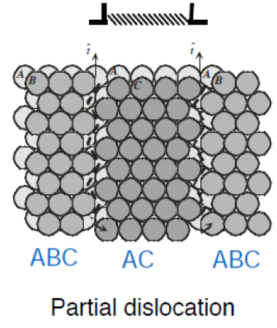
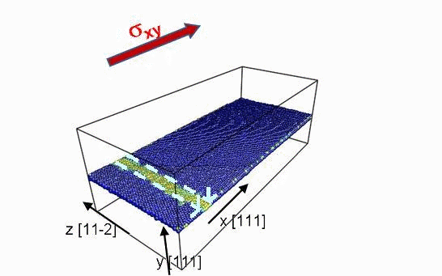
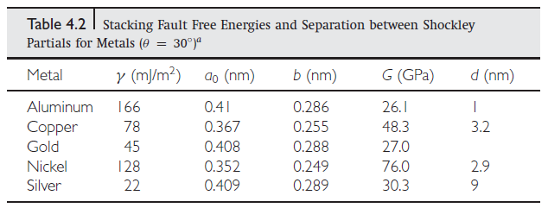
Partial Dislocations
While elastic strain energy is lowered, we have forgotten that our material is no longer in its preferred stacking sequence.
ABCABCABC → ABCACABC
As with any defect, this stacking fault adds energy to our system.

Slide 12
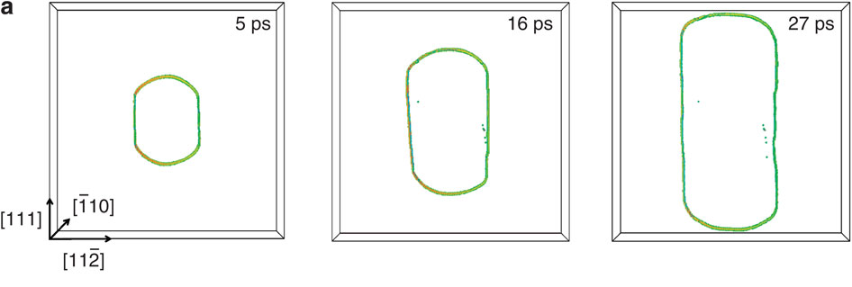
Body Centered Cubic
2) Body centered cubic (BCC)
Fe, W, V, Mo, Cr, Ta
(steel if in ferrite phase, which is stable at RT)
a_{o}
Not close packed! Atoms touch along the diagonal of a {110} plane.
a_{o}
a_{o}
a_{o}
There is no obvious zig-zag path that will reduce the elastic strain energy. No partials!
$\sqrt{2}$a_{o}
v_{screw} << v_{edge} for BCC
b = a/2 <-111>
{110} planes

Slide 13
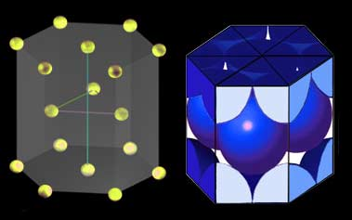
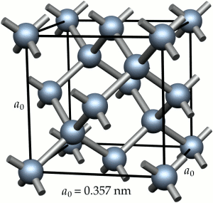
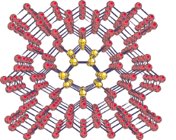
Other Crystal Structures…
Hexagonal Close Packed (HCP)
Ceramics (e.g., Si)
Ceramics usually have more complex unit cells and directional bonding. For example, Si forms in the diamond cubic unit cell (FCC+…).
Instead of ABCABC stacking of the FCC lattice, stack atoms in ABABAB ordering.
Dislocations have more complicated “cores.”
Need 5 independent slip systems to accommodate an arbitrary shape change. HCP only has 2 independent!
Harder to move!

Slide 14
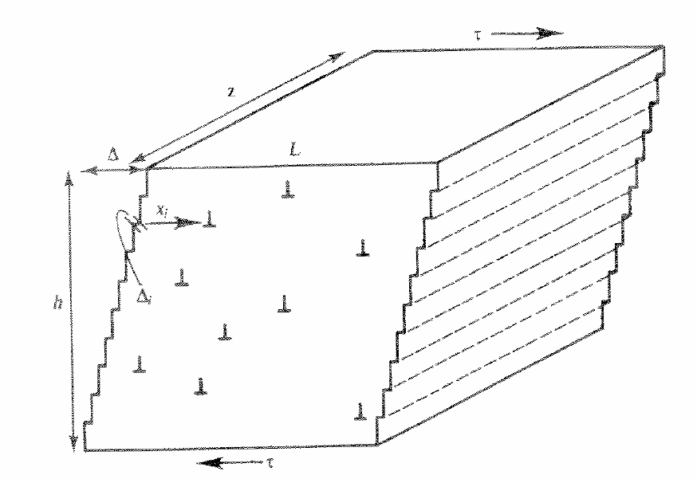
Connecting to Macroscale Behavior
How much shear strain will a single dislocation produce?
b
Let’s start with a cube that is 1 cm in all dimensions.
(e.g., b ~ 0.3 nm for Ti)
h
$$γ_{i}= \frac{b}{h} ≈3 × {10}^{−8}$$
Therefore, we must have many dislocation events for an appreciable plastic strain.
$$γ = \frac{n∙b}{h}$$
For γ = 0.01 → n ≈ 10⁶ dislocations

Slide 15
Dislocation Density
Real materials have plenty of dislocations, so such a high number is not unreasonable.
Dislocation density is used to describe the dislocation content of a material.
Number of dislocations that cut through a unit cross-sectional area
OR
Total line length of dislocations per unit volume
$$ρ = \frac{n}{Area}= \frac{n∙L}{A∙L}$$
L
Material | ρ_{disl} [m⁻²]
Well-annealed metal | 10¹⁰ - 10¹²
Cold-worked metal | 10¹⁴ - 10¹⁵
Carefully grown semiconductors | 10⁵
Whiskers (nearly perfect…) | ~ 0

Slide 16
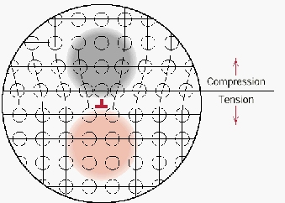
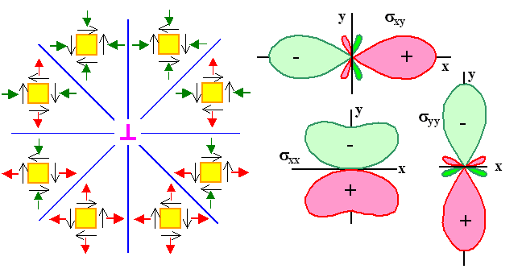
Dislocation Interactions
Dislocations have strain fields associated with them, which causes them to interact with other dislocations in interesting ways.
Opposite signed dislocations attract.
Like dislocations repel.

Slide 17
Image Forces
In a similar way, the stress and strain fields of dislocations can interact with interfaces between other materials or even free surfaces.
u = ½ G b²
Stiffer material
Materials are driven to free or more compliant surfaces, while they are driven away from stiffer surfaces. These forces can be represented by thinking about a hypothetical dislocation, or image dislocation.
Infinitely Stiff
Free surface

